Slide 1

Basic Details of the Team and Problem Statement
Ministry/Organization Name/Student Innovation: Government Of Jharkhand
PS Code: SIH1500
Problem Statement Title: Enhance Learning With VR for Specially Abled.
Team Name: BE-UP
Team Leader Name: NANTHINI PRIYA.R
Institute Code (AISHE):C – 16570
Institute Name: Agni College Of Technology
Theme Name: Smart Education

Slide 2
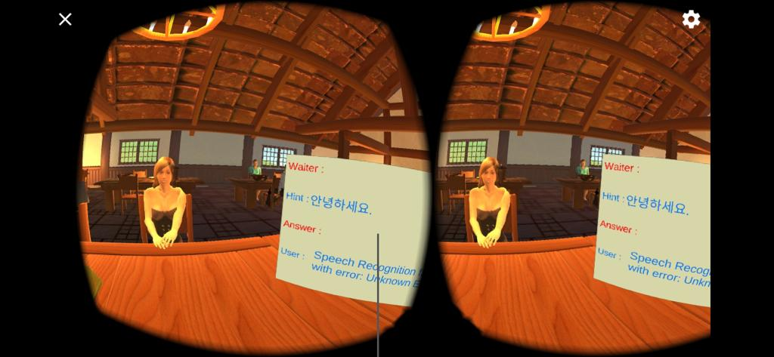
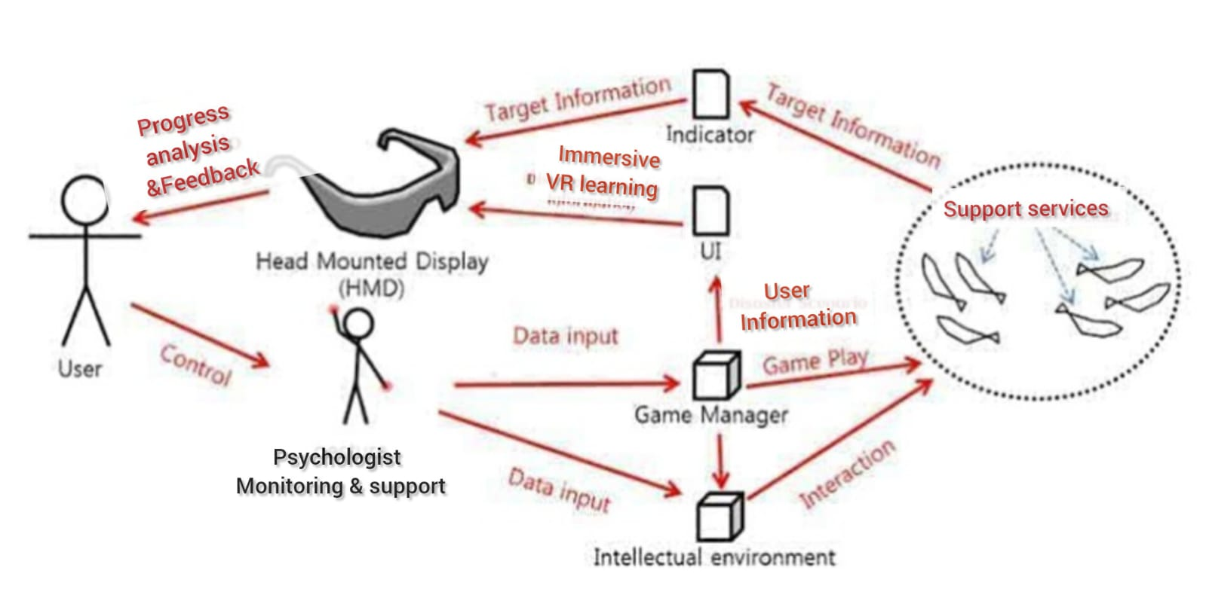
Enhance Learning With VR for Specially Abled.
Grammar-Quest VR: Revolutionizing English Grammar Education with Immersive Virtual Reality.
Describe your idea/Solution/Prototype here:
An immersive journey into the world of Virtual Reality (VR) education, designed to empower and integrate individuals with neurodevelopmental disorders, with a specific focus on autism spectrum disorder (ASD).
Our VR education modules are thoughtfully crafted to provide a safe, nurturing, and interactive space for neurodiverse individuals.. "Empowering Minds" is more than just a virtual classroom; it's a conduit to help neurodiverse learners unlock their full potential.
Our VR environment enables them to develop essential life skills, engage in meaningful social interactions, and explore their unique talents.
To promote a sense of belonging and confidence in their abilities for enabling learn at their own pace and adapt to their preferred learning style.
To help the specially-abled children to absorb the natural flow of life and make them feel normal.
Together, we can bridge the gap and ensure that every individual, regardless of their neurodevelopmental profile, feels not just nurtured but also naturally integrated into the rich tapestry of human existence.
Describe your Technology stack here:
VR Development:
Unity or Unreal Engine for VR development.
Oculus Rift or meta for VR hardware.
Gaze tracking technology (e.g., Tobii) for user input.
Backend and Analytics:
Backend development with Python (Django or Flask) or Node.js for managing user data and analytics.
Database management using PostgreSQL or MongoDB.
This technology stack provides a foundation for creating the VR environment and managing user data and analytics effectively.

Slide 3
Idea/Approach Details
Describe your Dependencies / Show stopper here
Describe your Use Cases here
Hardware and Technology: Ensure VR hardware accessibility and the reliability of gaze input tracking technology.
Content Development: Address challenges related to content creation, adaptability, and personalization.
User Engagement and Safety: Manage logistical challenges with psychologist involvement and prioritize user safety in the VR environment.
Regulatory and Ethical Considerations: Adhere to ethical and privacy standards, obtain necessary approvals, and meet accessibility requirements.
Funding and Resources: Secure financial resources, technical expertise, and conduct scientific validation to ensure the platform's effectiveness and success in the market.
The proposed system is an adaptive virtual reality learning platform that takes place in a VR environment to provide a analogy base teaching ecosystem, designed to cater to the unique needs of individuals with Neurodevelopmental Disorders (NDD).
The platform uses behavior analysis and gaze input tracking to minimize explicit user input and modulate the complexity of gameplay based on the user's behavior.
A psychologist accompanies the user during gameplay to monitor their progress, provide assistance when needed, and analyze the results to gain a better understanding of the user's condition.

Slide 4
Team Member Details
Team Leader Name: Nanthini Priya R
Branch : B.Tech Stream : Information Technology Year (I,II,III,IV): III
Team Member 1 Name: Mahima Sree S
Branch : B.Tech Stream : Information Technology Year (I,II,III,IV): III
Team Member 2 Name: Sri Rakshaga SR
Branch : B.E Stream :ECE Year (I,II,III,IV): IV
Team Member 3 Name: Ashika Jubi S
Branch : B.Tech Stream : Information Technology Year (I,II,III,IV): III
Team Member 4 Name: Praveen M
Branch : B.Tech Stream : Information Technology Year (I,II,III,IV): III
Team Member 5 Name: Parvish J
Branch: B.E Stream : Mechatronics Year (I,II,III,IV): III
Team Mentor 1 Name: Dr Sureka N
Category (Academic/Industry): Academic Expertise : Embedded and AI Domain Experience (in years): 10 Years
Team Mentor 2 Name: Solomon Sagayam DJ
Category (Academic/Industry): Academic Expertise: Machine Learning, Domain Experience(in years): 2 years
AI and Unity Blending

